Slide 1
Genetic Algorithm Demonstration
Alec, Peyman, Stephen, Tom

Slide 2
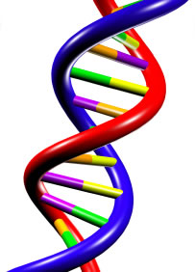
Concept: Genetic Algorithm
Inspired by biological processes
Reproduction
Evolution (natural selection)
Optimization of large problems
Solutions’ parameters represented by genes
Three steps:
Crossover
Mutation
Selection
Begin with two potential solutions (initial population)

Slide 3
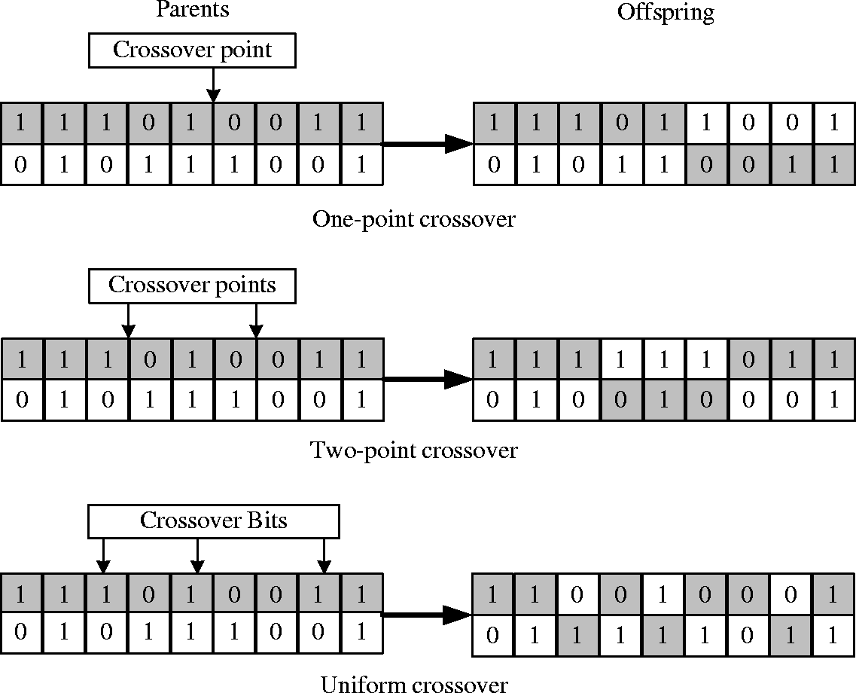
Genetic Algorithm: Crossover
Two parents are chosen
Each gene is chosen from one parent
A child is generated with the chosen genes
Repeat for many children to create population

Slide 4
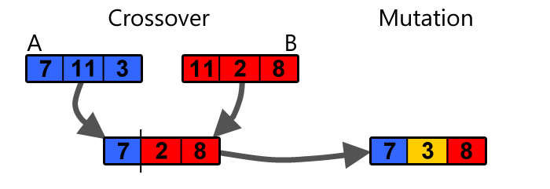
Genetic Algorithm: Mutation
Don’t want to limit solutions to genes of initial population
Each child has a chance of mutation
One or more genes are changed randomly

Slide 5
Genetic Algorithm: Selection
Also called a “tournament”
Genes are ranked according to a fitness function
Generally corresponds with optimality
Best two are picked to generate the next population

Slide 6
System Goal
Show the process of convergence in the genetic algorithm
Solutions will be represented as images on the LED matrices
Each red, green, and blue component of each pixel will be a gene
Optimal solution will be a predefined target image
Fitness function will be closeness to the target image
Initial population will be four robots
When robots collide, they will perform crossover, mutation, and selection
Each robot will keep one of the best two children
Over time, the robots’ displays will transform from random pixels to the target image

Slide 7
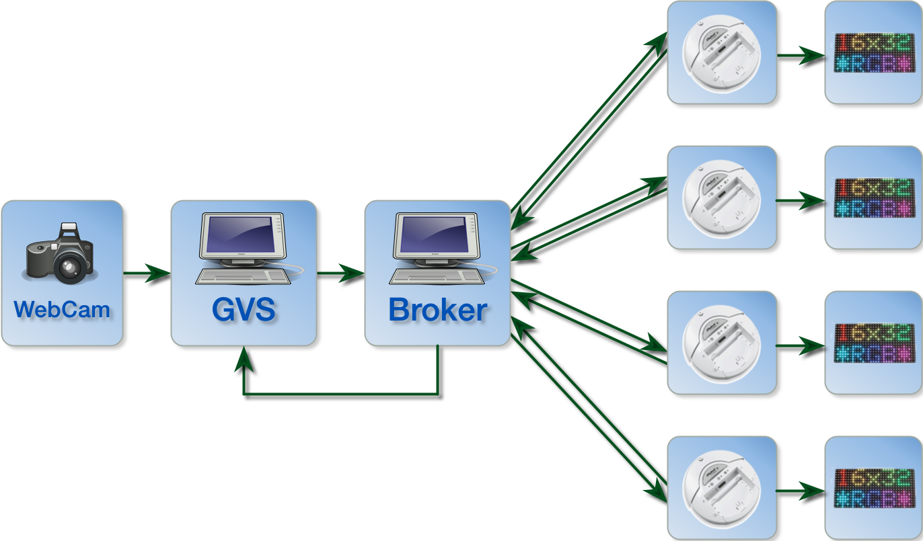
Implementation Overview
Top-Level System Actor Model Diagram

Slide 8
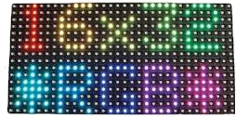
LED Matrix
16x32 RGB LED Matrix
A PWM-based algorithm to control RGB LEDs
brightness controls with 256 levels
24-bit color
Maximum of 16 rows by 32 columns of 8-bit RGB values
Restiction on target, parents, and children images

Slide 9
LED Matrix
If the refresh rate is too low, the LEDs will flash
FPGA on myRio is utilized to provide a high refresh rate
A 5 MHz clock is used to shift data into the LED Matrix
Frame rate of 72fps
The FPGA is programmed using VHDL and LabView VIs

Slide 10
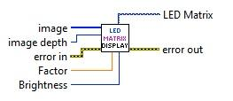
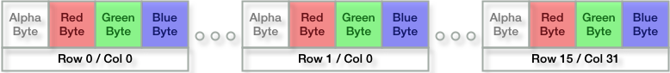
LED Matrix Display VI
Image: A 1-D U8 byte array with the image data. Should be 1536 bytes long.
Image Depth: Color bit depth. Only 24 or 32 are currently supported. Other values = error.
Format of the 1D byte array for 24-bit image depth:
For 32-bit Image Depth, the extra alpha byte gets discarded
Notes:
The color bytes are ordered as red, green then blue bytes. The first 3-tuple of color bytes is the color of the top left pixel on the display. The 3-tuples continue along a row, left to right. At the end of a row, the next 3-tuple of color bytes is the color of the leftmost pixel on the next row below the current one. This continues for 512 3-tuple bytes.

Slide 11
LED Matrix Display VI
Brightness Control
Factor (optional): Gamma correction
Default = 1 (disables the effect)
Small values 1.2 - 2.5 (seem to work best)
Brightness (optional):
Range = 0 (off) to 100 (full brightness)
Default = 50
The brighter the LEDs, the more battery power gets consumed ( up to 12.5W)
Experiment with these inputs to see what looks best

Slide 12
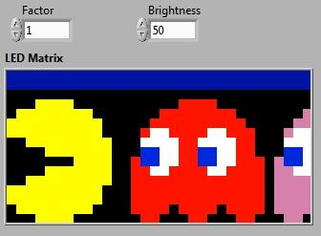
LED Matrix Display VI
Debug / Simulation Support
LED Matrix (optional): Picture output
Use it on your LabView Front Panel to indicate what the LED Matrix should be displaying.
Allows use of the VI for simulation when the physical LED Matrix is not available

Slide 13
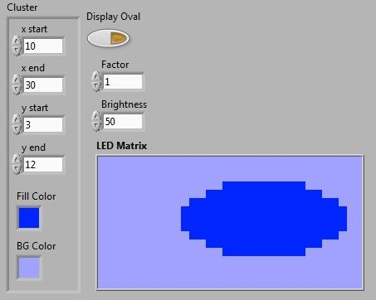
LED Matrix Display VI
IMAQ Overlay Blocks for Drawing
NI Vision toolbox
Cannot use Picture VIs due to a restriction with RT LabView
LED Matrix project has some examples
Draw Oval in arbitrary location
Draw text in any position and size
However, not the prettiest!!!

Slide 14
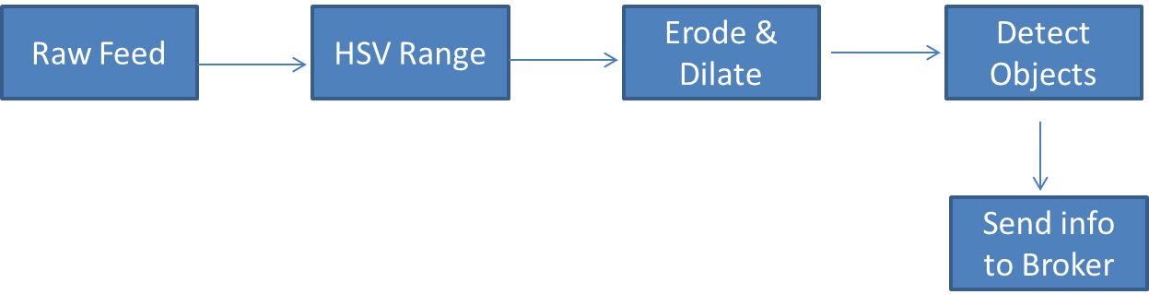
Global Vision System (GVS)
Continuously detect marks
Update coordinates
Transmit data to the broker
Stop when “DONE” is received

Slide 15

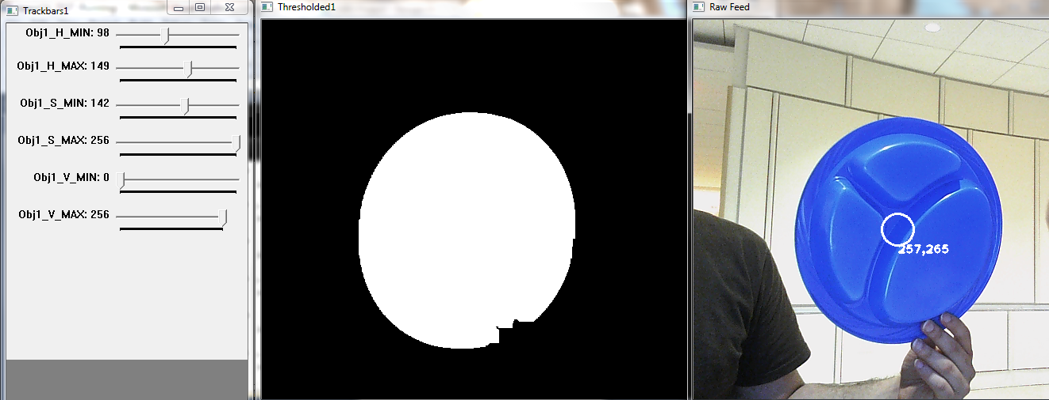
Configuration (User Interface)

Slide 16

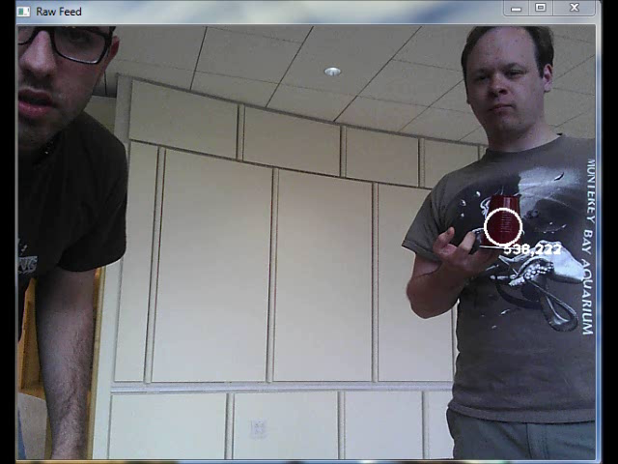
GVS Demo

Slide 17
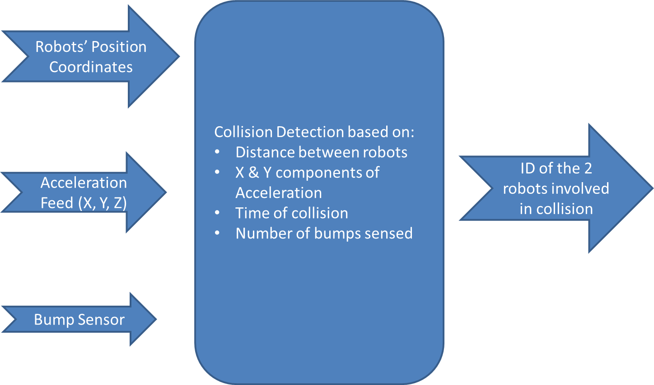
Collision Detection Model

Slide 18
Broker
TCP Server
Determines if robots have collided, and which robots were involved in the collision.
Forwards messages between robots.
Messages from GVS
Communication Broker
Messages to GVS
Messages from Robot
Messages to Robot

Slide 19
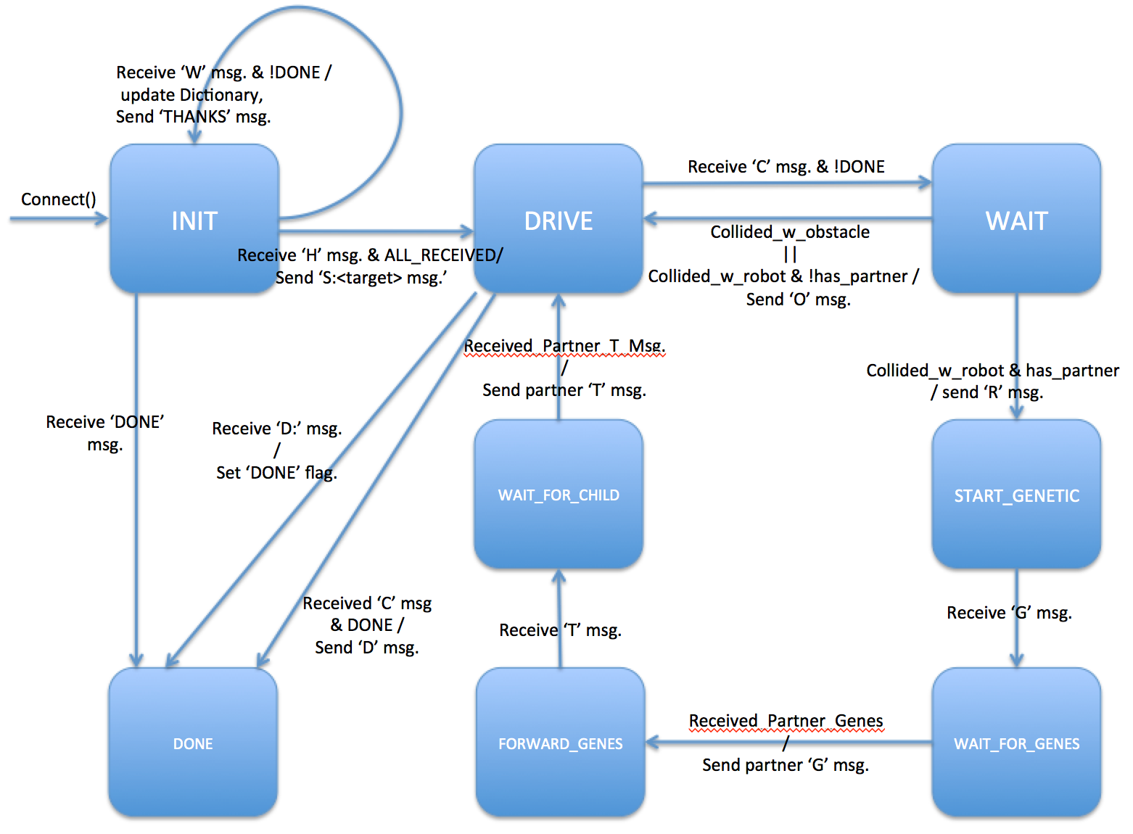
Broker State Machine
GVS Message Formats
RX
W:<Color>:<X-coor>,<Y-coor>
TX
THANKS
DONE
Robot Message Formats
RX
H:
C:
G:<Parent Genes>
T:<2nd best child Genes>
D:<Result Image>
TX
S:<Target Image>
O:
R:
G:<Parent Genes>
T:<2nd best child Genes>
D:<Result image>

Slide 20
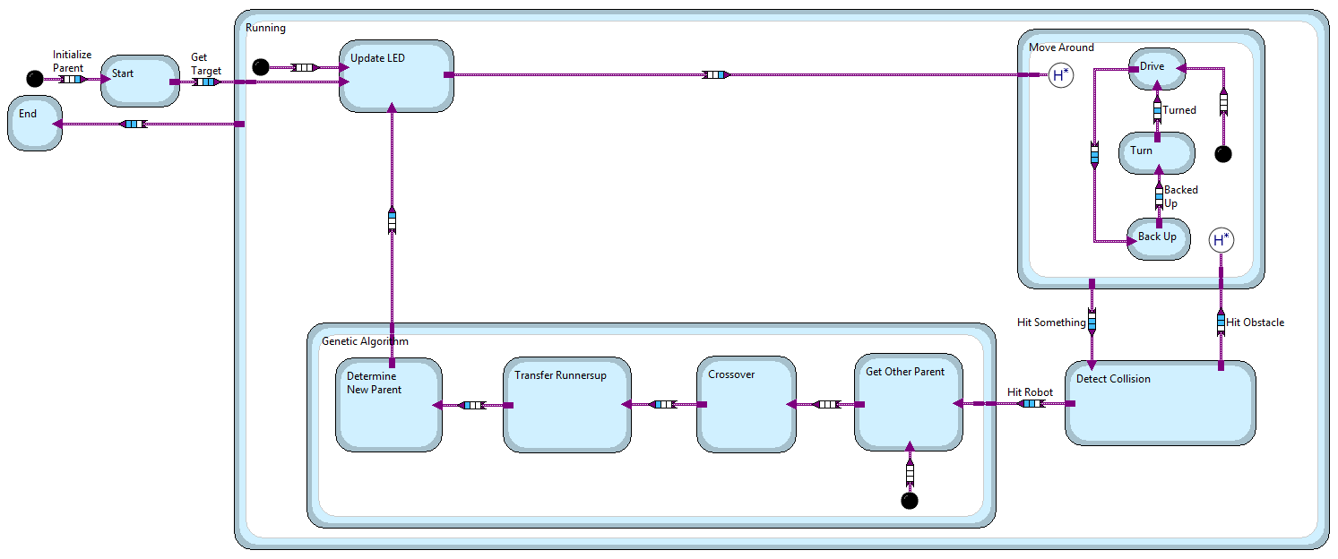
Robot
Reached target image

Slide 21
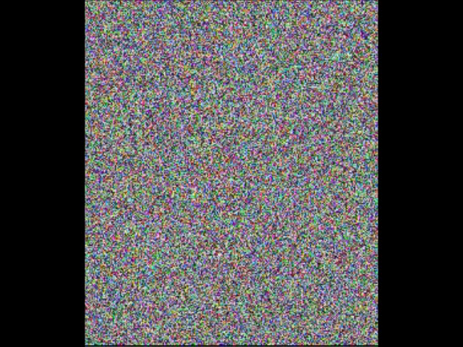
Genetic Algorithm: Example

